Slide 1




Generative Artificial Intelligence
Paul Dubois
Info@Lèze

Slide 2
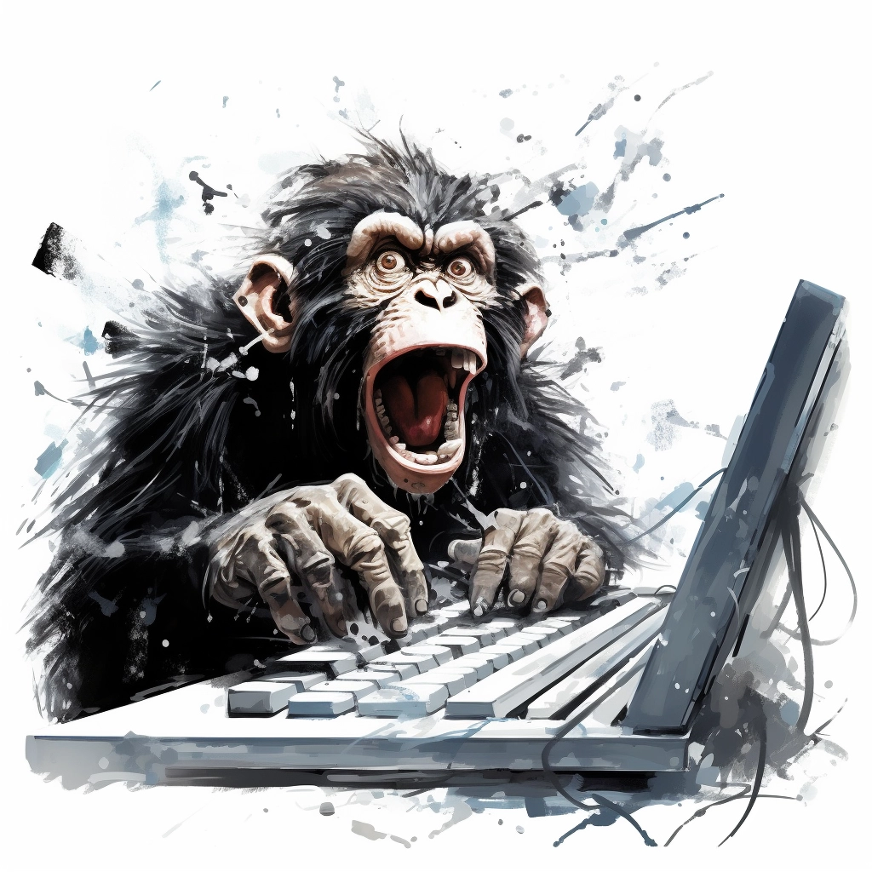
Creating new Words

Slide 3
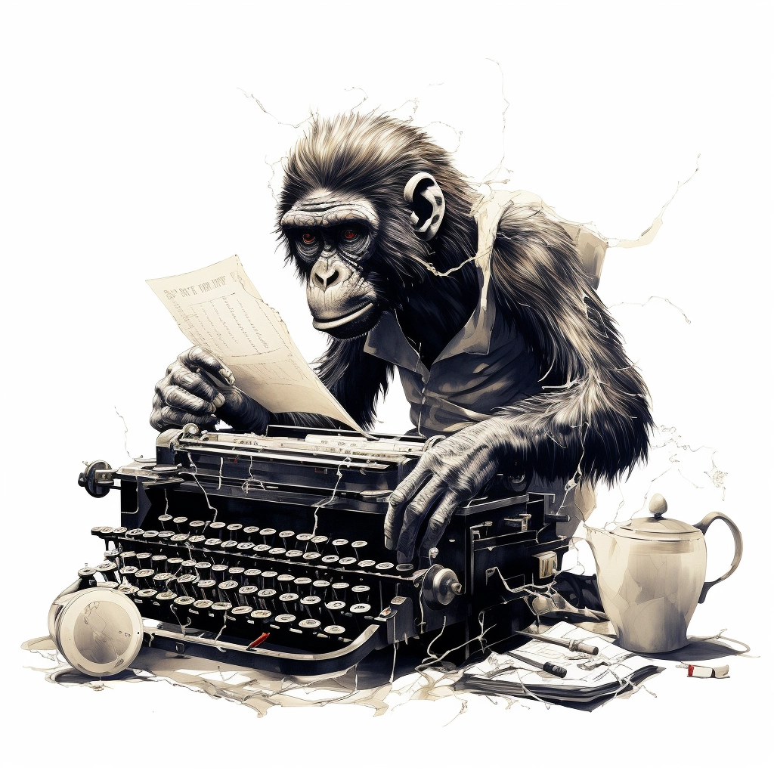
Method #1:
Randomly Type on a Keyboard

Slide 4
Method #2:
Type on a Weighted Keyboard

Slide 5
Method #3:
Dynamically Weighted Keyboard

Slide 6
Predict letters

Slide 7
Generator vs Discriminator

Slide 8
Denoising

